Slide 1




Rascal: Rendezvous and Proximity Operations
Team Bravo
Jennifer Babb
Bryant Gaume
Tom Moline
Tyler Olson
Nate Richard
Fixed-Design Presentation
February 20, 2013

Slide 2
Project Overview
Design Constraints
Mission Design

Slide 3
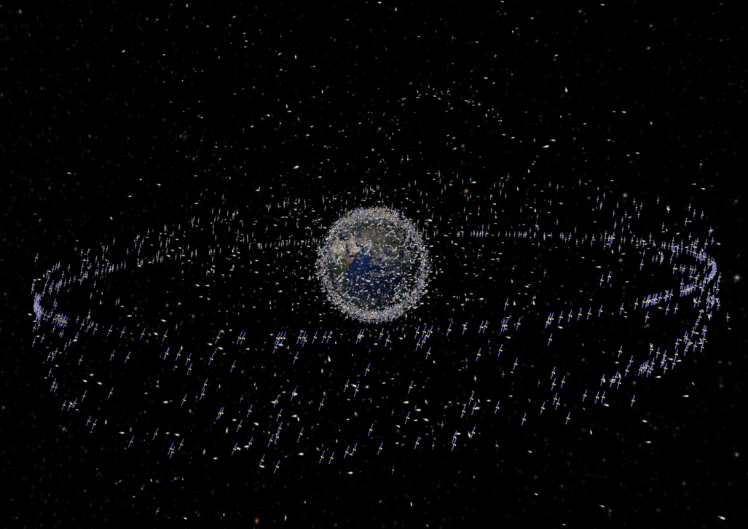
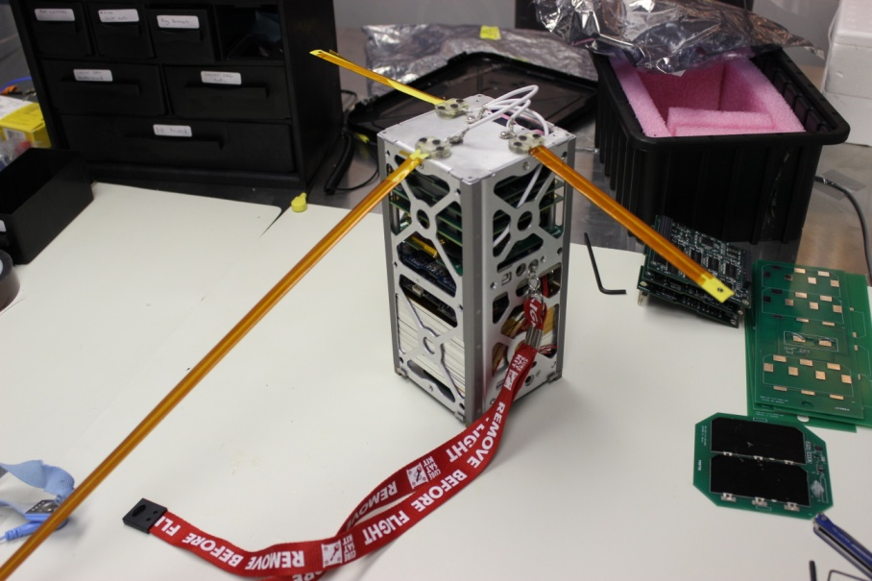
Rascal Mission Overview
Rascal is a CubeSat mission that seeks to demonstrate rendezvous and proximity operations within a small satellite architecture.
Proximity operations consist of orbital maneuvers that change the relative position between two resident space objects.
Demonstration of said proximity operations have been targeted by NASA as key area of development for future spacecraft missions.

Slide 4
Rascal Mission Success Criteria
In order for the Rascal mission to be considered successful, it must meet the success criteria listed below.
The Rascal mission shall demonstrate:
Stationkeeping: performing correction maneuvers to remain within a 10-75 meter sphere of a resident space object for at least 5 orbits.
Collision Avoidance Maneuver: performing an orbital maneuver that intentionally increases the final displacement of the spacecraft relative to a resident space object to at least 100 meters within 1 orbit.
Rendezvous: performing an orbital maneuver that intentionally decreases the displacement of the spacecraft relative to a resident space object to within 50 meters for at least 5 orbits.

Slide 5

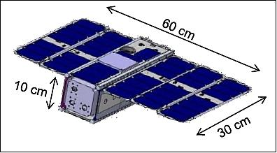
Boeing Partnership
The Rascal mission, as currently defined, has been selected as a part of Boeing’s Advanced Space and Intelligence Systems (AS&IS) search for university satellite programs whose mission goals and designs can best translated to wide-scale use within the greater satellite industry.
As such, the majority of the work for the Rascal mission will concentrate on both mission definition and payload development for the spacecraft bus developed by the AS&IS.

Slide 6
Project Overview
Design Constraints
Mission Design

Slide 7
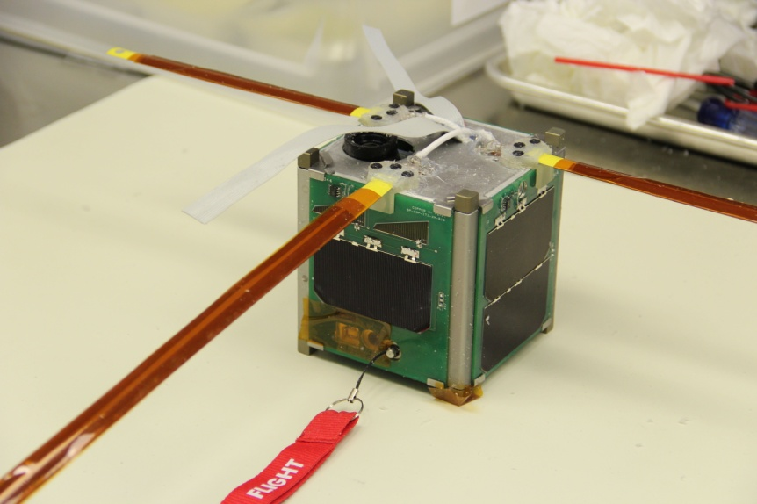
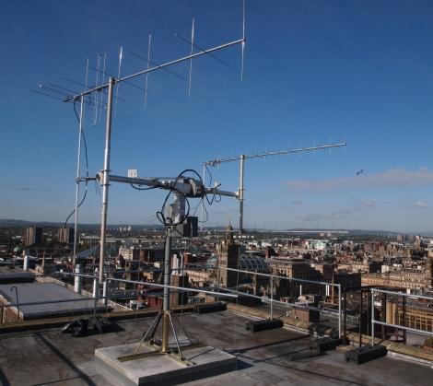
Design Constraints
Parameter | Constraint
Design Life | 1 to 3 Years
Payload Mass | 1.83 kg
Payload Power | 35 Watts
Payload Size | 1U (10cm x 10cm x 10cm)
Radio Specifications | UHF or S-Band
Mass Data Storage | 8 GB
Propulsion | 150 m/s (Not Necessarily with 6 DOF)
Launch Environment | CubeSat GEVS Standard

Slide 8
Orbit Analysis (1)

Slide 9
Orbit Analysis (2)

Slide 10
Radio Analysis
SLU Ground Station
100 W Transmit Power
15 dB Gain
Propagation Range
300 km Altitude
5⁰ Elevation Angle
UHF Radio
440 MHz
5 W Transmit Power
5 dB Gain
Downlink: 100kbps
Uplink: 4 kbps
Signal-to-Noise Ratio: 13.47 dB
S-Band Radio
2.4 GHz
5 W Transmit Power
5 dB Gain
Downlink: 1.1 Mbps
Uplink: 4 kbps
Signal-to-Noise Ratio: -4.17 dB

Slide 11
Project Overview
Design Constraints
Mission Design

